Slide 1

Introduction to Blockchain & Cryptocurrencies
FIN 494 - Introduction to Blockchain & Crypto
Mabel Oza (moza2@uic.edu)
https://github.com/moza88/UIC-Blockchain-Crypto
Wednesdays & Mondays @ 4:30 PM to 5:45 PM
Douglass Hall 330* (Unless Notified)
*

Slide 2
AGENDA
Course Materials
Goals
Bitcoin
Blockchain

Slide 3
COURSE INFO
Location
We'll meet at DH 330 most days
How to Reach Me
Email me
Some days we’ll meet at DH 170 (computer lab)
Office Hours -> Wednesday (3:00 - 4:30)
Final Exam & Final Project
Final exam tests your ability to do blockchain transactions
Final project is a presentation of a blockchain or crypto project
Course Materials are on Github
Need a Github account
If your work is good, it can be showcased on the Github

Slide 4
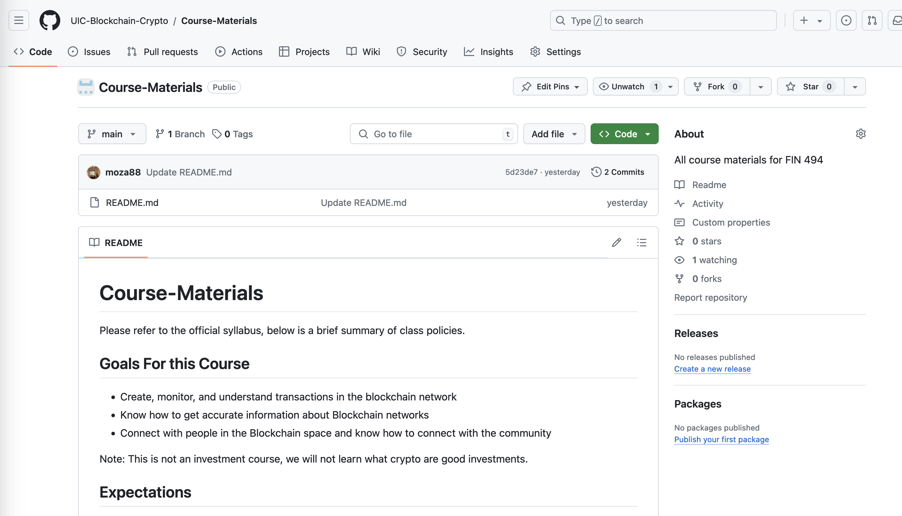

COURSE MATERIALS
Need you need a Github Account (Send me your account username by the next class)
Anyone can contribute to the Github
Github Organization (https://github.com/orgs/UIC-Blockchain-Crypto/)
Course material is all on our Github
Major Blockchain projects (Bitcoin, Ethereum, etc.) are on Github

Slide 5
GOALS
Explain what is Blockchain and Cryptocurrencies
Be able to create and monitor blockchain transactions
Create and manage a crypto wallet
Understand fundamental blockchain concepts
Know how to learn more about blockchain & connect with the community

Slide 6
DISCLAIMER
This isn't a crypto trading course
You don't have to like cryptocurrencies or blockchain to learn it
Guarantee: You will have the right tools to research many blockchain & crypto related topics on your own -> Accurately
The ecosystem is huge, and we'll only learn 1% of what's in this space

Slide 7
MAJOR TOPICS IN BLOCKCHAIN ECOSYSTEM
Crypto Mining
Crypto Custody (Wallets for individuals and organizations)
Crypto Trading
DeFi Investment Products
Decentralized Storage
NFTs (Art, Gaming, and Metaverse)
SSI (Self Soverign Identity)
Stablecoins
Central Bank Digital Currencies (CBDCs)
Decentralized Autonomous Organizations (DAOs)
Crypto Regulations & Taxation

Slide 8

BLOCKCHAIN NETWORKS & CRYPTOCURRENCIES
Blockchain Networks
Layer 2 Blockchain Networks
Bitcoin Blockchain Network
Lightning Network
Rootstock Network
BTC
More…
Ethereum Blockchain Network
Polygon Network
Base Network
USDC
SHIB
USDT
LINK
ETH
More..
More…
Solana Blockchain Network
USDC
HNT
GRT
RNDR
SOL
More..
Notes:
https://www.youtube.com/watch?v=LRiA2OWGwtw&ab_channel=Chainlink

Slide 9
Bitcoin
The beginning…
*

Slide 10

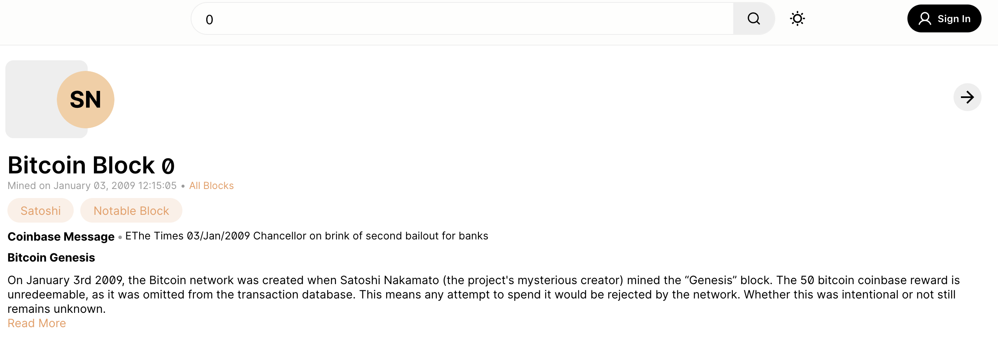
BITCOIN
In 2008, Satoshi Nakamoto published a whitepaper outlying the Bitcoin
On January 2009 Bitcoin was launched (see Genesis Block to the right)
Santoshi collaborated on Bitcoin till mid-2010 and gave the source code repository to Gavin Andersen
Bitcoin laid the foundation for many blockchain projects today
A Peer-to-Peer Electronic Cash System: https://bitcoin.org/bitcoin.pdf

Slide 11
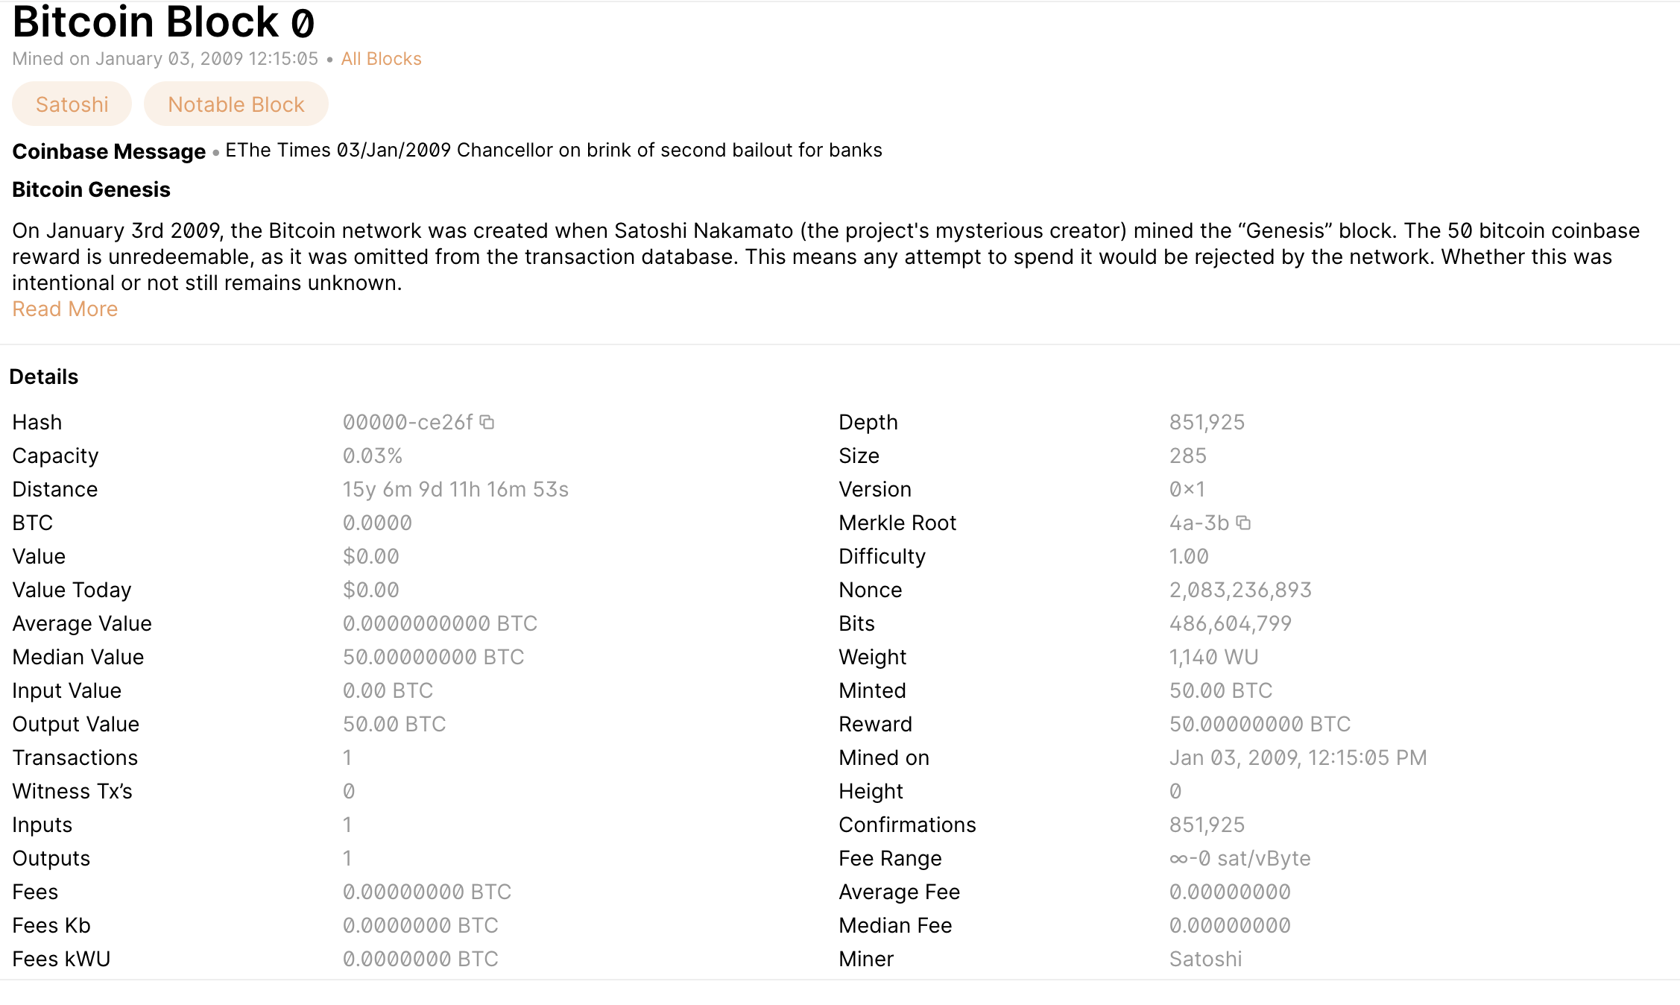
BITCOIN – GENISIS BLOCK
The coinbase in Bitcoin blocks refers to the first transaction in a block, which is a special transaction that generates new bitcoins.
Difficulty measures of how hard it is to find a hash below a given target, it adjust every 2 weeks to ensure txns take 10 mins
Reward the miner gets for mining the block
Date block was mined
Who created this block

Slide 12
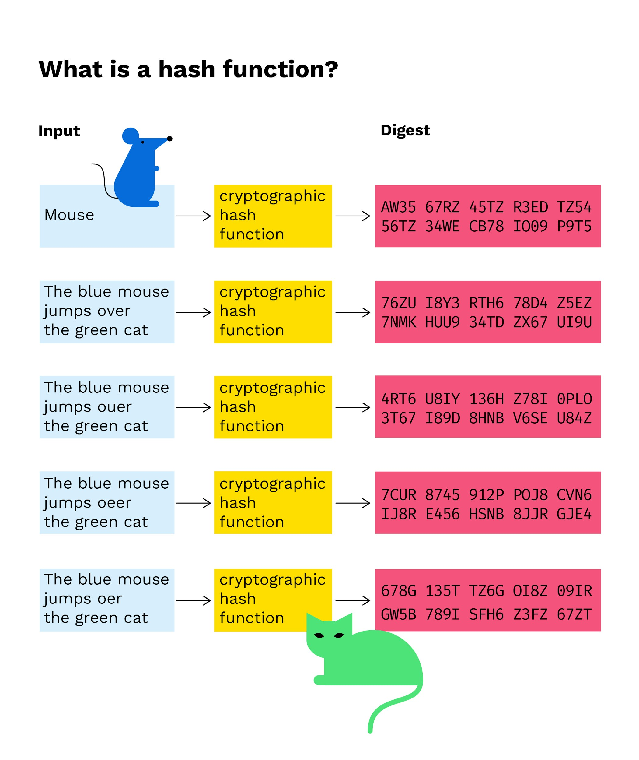
HASHING
Turning a data record to a data record into a fixed-length character string using a cryptographic function
Immutability: Summarize all the transactions in a block and allow blocks to reference previous blocks
Each hash value is distinct and often referred to as fingerprints
In blockchain hashing is used in the following ways:
Consensus: Hashing is used to validate transactions
Transaction IDs: Ensures transactions have unique references
Address Generation: Uses public keys and creates unique addresses
Merkle Trees: Enables quick verification in hierarchical structure of transactions
Notes:
https://gugger.guru/blockchain-demo/#!/block
https://andersbrownworth.com/blockchain/
https://www.youtube.com/watch?v=LRiA2OWGwtw&ab_channel=Chainlink
Hashes play a crucial role in blockchain technology, serving multiple essential functions. Here's an overview of how hashes are used in blockchain:
1. Data Integrity and Security
Immutable Records: Each block in the blockchain contains a hash of the previous block, ensuring the integrity of the chain. If any data within a block is altered, the hash of that block changes, breaking the chain's continuity and signaling tampering.
Data Encryption: Hash functions transform data into a fixed-size string of characters, which helps secure sensitive information. For instance, user credentials and transaction details can be hashed to protect privacy.
2. Consensus Mechanisms
Proof of Work (PoW): In PoW-based blockchains like Bitcoin, miners solve complex mathematical problems that involve hashing to validate transactions and create new blocks. The first miner to solve the problem and find a hash meeting the network's difficulty level gets to add the new block and receive a reward.
Proof of Stake (PoS): Even in PoS systems, hashing algorithms are used to validate transactions and ensure data integrity, though the consensus mechanism differs from PoW.
3. Transaction Identification
Unique Identifiers: Each transaction in a blockchain is identified by a unique hash, known as a transaction ID. This ensures that each transaction can be uniquely referenced and traced throughout the blockchain.
4. Address Generation
Cryptographic Addresses: Blockchain addresses are often generated using hash functions. For example, Bitcoin addresses are derived from public keys using hash functions like SHA-256 and RIPEMD-160, ensuring a secure and unique identifier for each user.
5. Merkle Trees
Efficient Data Verification: Merkle trees use hashing to create a hierarchical structure that allows efficient and secure verification of data. Each leaf node in a Merkle tree is a hash of a data block, and each non-leaf node is a hash of its child nodes. This structure enables quick and reliable verification of data integrity in large datasets.

Slide 13

BLOCKCHAIN
Shared Ledger System that provides traceability, permanence, transparency.
Txns are grouped in a block
Block 0
Prev. Hash – 0
Hash – 123
Transactions
f5f0e89…
u3bc21…
Block 1
Prev. Hash – 123
Hash – 456
Transactions
q3ue89…
x6bc11…
Block 2
Prev. Hash – 456
Hash – 768
Transactions
y9bo89…
z1tc51…
Both copies of the ledger must equal each other.
If one is longer than the other the longer one wins.
Party A
Block 0
Prev. Hash – 0
Hash – 123
Transactions
f5f0e89…
u3bc21…
Block 1
Prev. Hash – 123
Hash – 456
Transactions
q3ue89…
x6bc11…
Block 2
Prev. Hash – 456
Hash – 768
Transactions
y9bo89…
z1tc51…
Party B
Notes:
https://blockchaindemo.io/?ref=producthunt

Slide 14
CRYPTOCURRENCIES
A digital asset/credit/unit within the system, which is cryptographically sent from one blockchain network user to another.
Include Ethereum, Bitcoin, Dodgecoin, Cardano, Solana, etc.
Key pairs that prove ownership of the cryptocurrency on the network, like a receipt
Digital asset based on a blockchain network
Most of them are distributed across several computers and do not require centralized control
Secured using cryptography

Slide 15
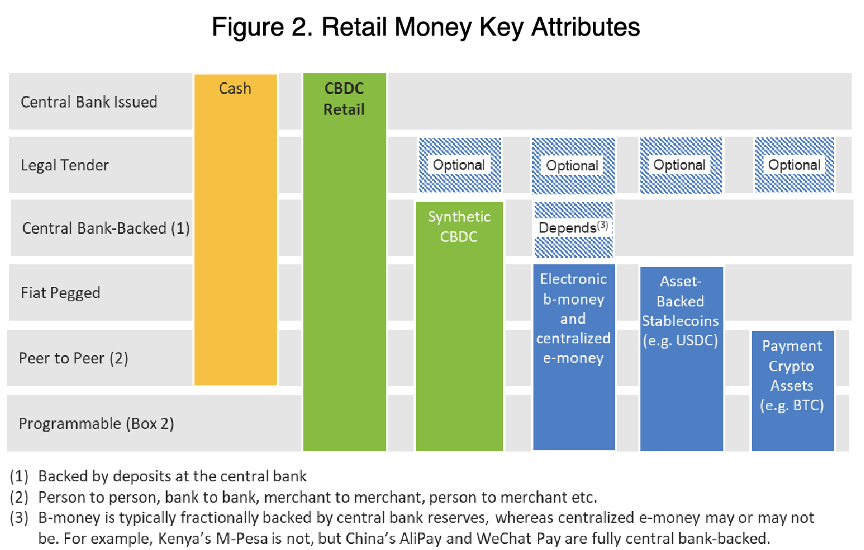
OTHER TYPES OF DIGITAL ASSETS
Stablecoins
CBDC (Central Bank Digital Currency)
Ex. USDC, UST, AliPay
Could be a ERC20 token (USDC) or a token create by a permissioned network
Made to avoid volatility and match the price of their peg (i.e. US dollar, Gold)
Ex. Digital Yaun (DCEP) & E-Krona
Digital representation of a sovereign currency issued by and as a liability of a jurisdiction’s central bank or other monetary authority
Centralized
Cryptocurrencies
Ex. Bitcoin & Ethereum
High volatility
Not backed by a collateral

Slide 16
HOMEWORK
Create a Github account and email me your username
Read the Bitcoin Whitepaper
There will be a quiz on it in the next class
Github Page
Bitcoin Whitepaper

